Slide 1
SCC204 Requirement Engineering (2)
-Example
Zhang Jinyu – zjy@bjtu.edu.cn
School of Computer and Information Technology
SD408

Slide 2
Mentcare -A patient information system for mental health care
A patient information system to support mental health care is a medical information system that maintains information about patients suffering from mental health problems and the treatments that they have received.
Most mental health patients do not require dedicated hospital treatment but need to attend specialist clinics regularly where they can meet a doctor who has detailed knowledge of their problems.
To make it easier for patients to attend, these clinics are not just run in hospitals. They may also be held in local medical practices or community centres.

Slide 3
Constrains
Mentcare is an information system that is intended for use in clinics.
It makes use of a centralized database of patient information but has also been designed to run on a PC, so that it may be accessed and used from sites that do not have secure network connectivity.
When the local systems have secure network access, they use patient information in the database but they can download and use local copies of patient records when they are disconnected.

Slide 4
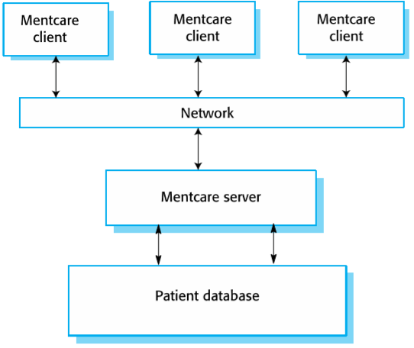
Organization of the Mentcare system

Slide 5
Stakeholders
Patients whose information is recorded in the system.
Doctors who are responsible for assessing and treating patients.
Nurses who coordinate the consultations with doctors and administer some treatments.
Medical receptionists who manage patients’ appointments.
IT staff who are responsible for installing and maintaining the system.

Slide 6
Exercise (1)
Write down five SHALL statements that capture the requirements for Mentcare.
The statements SHALL be easy to understand for your friends so that they can give you feedback.

Slide 7
Possible solutions (FR)
RM.1: A user shall be able to search the appointments lists for all clinics.
RM.2: The system shall generate each day, for each clinic, a list of patients who are expected to attend appointments that day.
RM.3: Each staff member using the system shall be uniquely identified by his or her 8-digit employee number.

Slide 8
Possible solutions (NFR)
RM.4: The Mentcare system shall be available to all clinics during normal working hours (Mon–Fri, 0830–17.30).
Downtime within normal working hours shall not exceed five seconds in any one day.
RM.5: The system shall implement patient privacy provisions as set out in the standard regulation.

Slide 9
Requirements imprecision
Problems arise when functional requirements are not precisely stated.
Ambiguous requirements may be interpreted in different ways by developers and users.
Consider the term ‘search’ in requirement 1
User intention–search for a patient name across all appointments in all clinics;
Developer interpretation–search for a patient name in an individual clinic. User chooses clinic then search.

Slide 10
Usability requirements
The system should be easy to use by medical staff and should be organized in such a way that user errors are minimized. (Goal)
Medical staff shall be able to use all the system functions after four hours of training. After this training, the average number of errors made by experienced users shall not exceed two per hour of system use. (Testable non-functional requirement)

Slide 11
Question?

